Slide 1



How could digital technologies
increase student wellbeing?
By Leo D Hirani

Slide 2
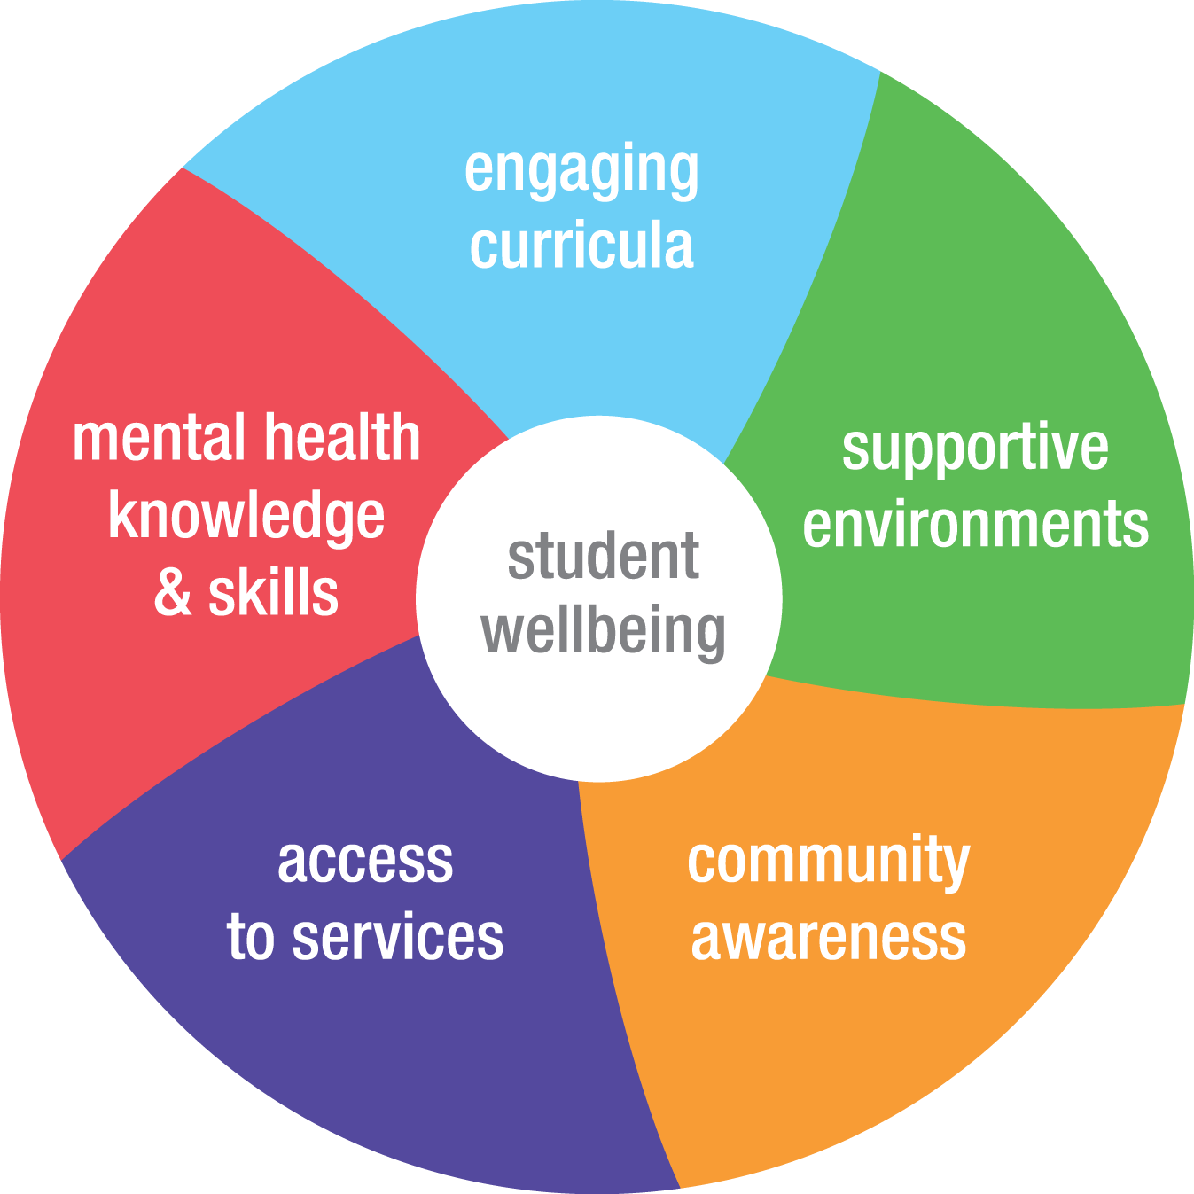
What is Student Well-being?

Slide 3



Slide 4
What is Tellmi?
Tellmi is a safe, anonymous app where you can talk about absolute anything. From anxiety to autism, dating to depression, or self-harm to self-esteem, you can share your experience with those in the community to feel better.

Slide 5
How is Tellmi used?
Moderated peer-to-peer support community.
Provides safe online support and guidance.
Free Subscription – Used by anyone.
Connects users with further professional help when required.
Human Moderators track your wellbeing and development. Tailored to connect to people your age.
Accessed via webpage, IOS, Android or Desktop/PC.

Slide 6
Advantages of Tellmi
Improves mental wellbeing – Helps users manage stress, anxiety, low mood, and other emotional difficulties.
Accessible from anywhere – Available on smartphones, allowing support to be accessed wherever there is an internet connection.
Reduces feelings of isolation – Connects users with a community, helping them feel less alone.
Encourages help-seeking behaviour – Makes it easier for users to reach out for support when they need it.
Provides coping strategies – Users can learn practical techniques for dealing with difficult situations and emotions.
Free to use for many users – Often provided through schools, colleges, universities, or healthcare organisations.
Supports students under pressure – Useful for managing exam stress, coursework deadlines, and academic anxiety.
Professional oversight – Moderators can identify when a user may need additional support and direct them to appropriate services.
Promotes emotional resilience – Encourages positive coping skills and self-confidence over time.
Easy to use – The app has a simple interface that is accessible even for users with little technical experience.
Confidential and private – Users can discuss sensitive topics without concerns about face-to-face judgement.

Slide 7
Disadvantages of Tellmi
Requires internet access – Users need a stable internet connection to access the app.
Not a replacement for therapy – The app cannot provide the same level of support as a qualified mental health professional.
Limited personal interaction – Online communication may feel less personal than face-to-face support.
Responses may not be immediate – Although available 24/7, users may need to wait for replies from peers or moderators.
Reliance on peer advice – Some suggestions from other users may not be suitable for every situation.
Not ideal for emergencies – Users experiencing a mental health crisis need urgent professional help rather than app-based support.
Privacy concerns – Some users may still worry about sharing personal information online, even anonymously.
Screen-time dependence – Increased use of digital devices may contribute to excessive screen time.
Potential misunderstanding – Written messages can sometimes be misinterpreted without tone of voice or facial expressions.

Slide 8
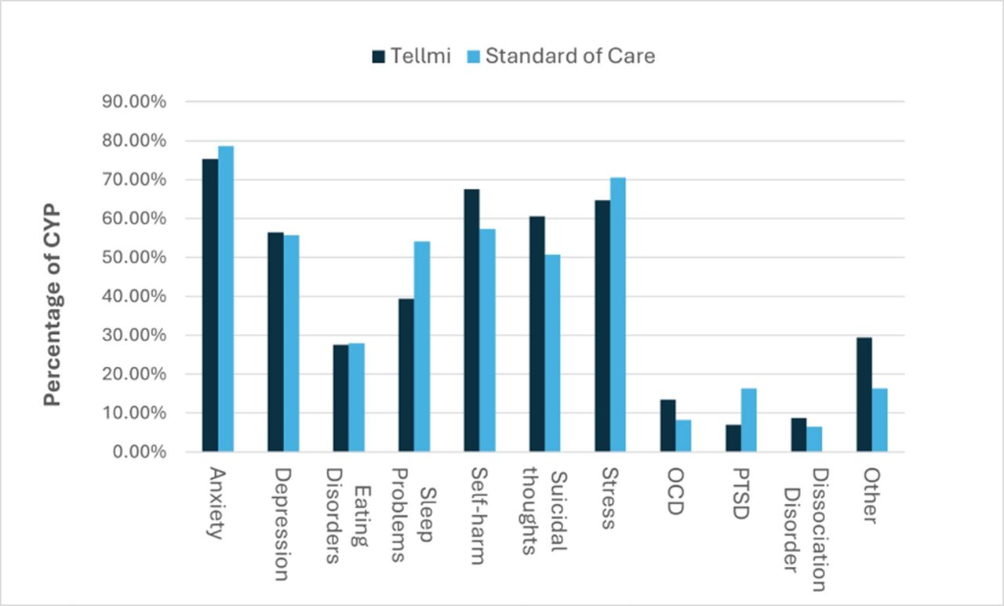
Tellmi Statistics

Slide 9
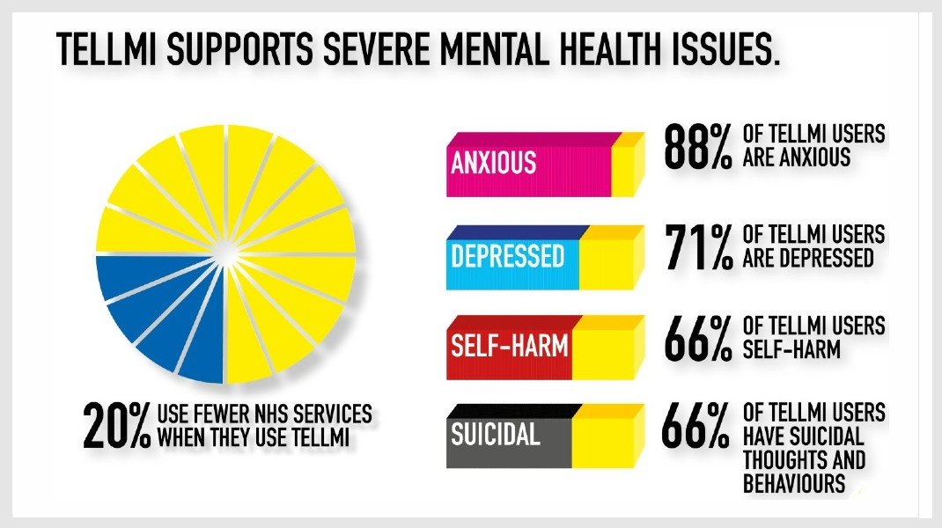
Tellmi Statistics

Slide 10
Conclusion
Tellmi provides a safe and accessible platform where young people and students can receive mental health and wellbeing support.
The app helps reduce feelings of stress, anxiety, and isolation through anonymous peer support and professional moderation.
Its ease of access and 24/7 availability make it a convenient resource for users seeking support at any time.
While Tellmi is a valuable wellbeing tool, it should complement rather than replace professional mental health services when more specialised support is needed.

Slide 11
References
https://www.tellmi.help/impact-evidence https://bmjpaedsopen.bmj.com/content/9/1/e003592 https://lightbulbtrust.org/impact-partner/tellmi/ https://www.sbrihealthcare.org.uk/impact-case-studies/case-studies/

Slide 12
Thank you for listening
Q&A Time

